Slide 1
Severstal Steel Defect Detection (Image Segmentation Architecture)
Springboard Capstone Project II
Shubham Tiwari

Slide 2
Table of Contents
01
02
Objectives
EDA & Image Segmentation
03
04
U-Net Architecture
Training Results & Conclusions
Introduction & Problem Statement
Exploratory Data Analysis & Metrics for Evaluation
Model Development
Conclusions & Future Work

Slide 3
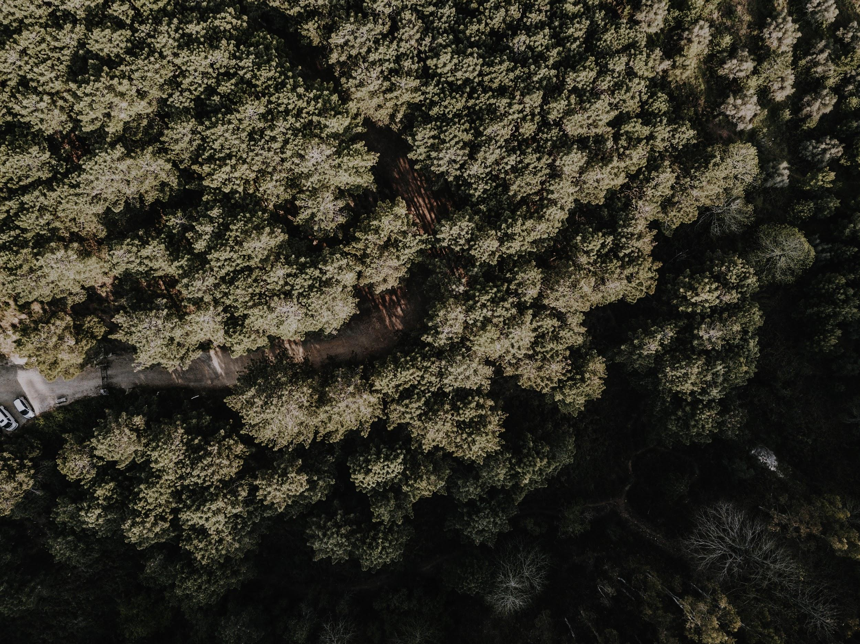
Introduction
The Severstal steel defects detection task is to localize and classify surface defects on a steel sheet. Flat sheet steel production is quite delicate.
Throughout the processes of heating and rolling, drying and cutting, several machines are in contact with the steel, and hence introduce a variety of defects on the surface. Severstal uses images from high frequency cameras to power a defect detection algorithm, and are continuously improving industrial algorithms using deep learning techniques.

Slide 4
Problem Statement
Acknowledgement
Problem Statement
To correctly segment by pixels and classify the 4 types of defects found in the steel sheets images.
Methodology
Create convolutional neural network (CNN) architecture used for image segmentation tasks, fit training images and check against the target metrics.
The following code has been completed with the help of xhlulu’s boilerplate code (xhlulu, 2019): The author graciously shared their work on public Kaggle kernels, and I was able to fork off of their work and introduce many of my own concepts.
xhlulu. (2019). Severstal: Simple Keras U-Net Boilerplate. (Kaggle ) Retrieved 08 05, 2019, from https://www.kaggle.com/xhlulu/severstal-simple-keras-u-net-boilerplate

Slide 5
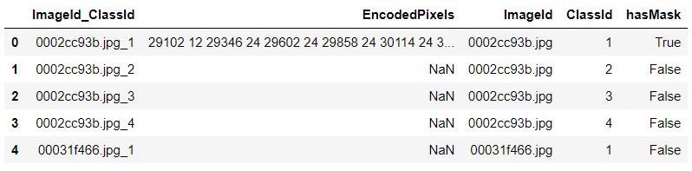
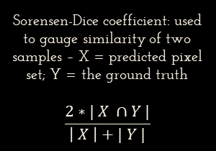
Dataset Description
Training Data
RLE Masks
Evaluation Metric
Training data file format
12568 images with 4 defects each
256 x 1600 pixels each
Labels include run-length encoded (RLE) image masks
'1 3 10 5' implies pixels 1,2,3,10,11,12,13,14 are to be included in the mask.
Sorensen-Dice coefficient: used to gauge similarity of two samples – X = predicted pixel set; Y = the ground truth
$$\frac{2∗| X ∩Y |}{\left| X \right|+| Y |}$$

Slide 6
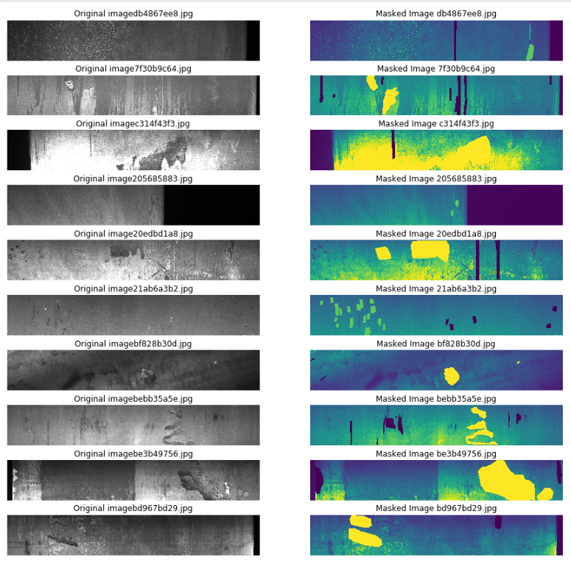
Problem Statement
Image and Mask Visualization
Built using OpenCV library and viridis color scheme
Images on the left are original
Images on the right are images with mask on
Color codes for the defects:
1 = green,
2 = light blue,
3 = dark blue,
4 = yellow.
Original (Left) and Masked Image Subset of the 12568 Steel Images

Slide 7
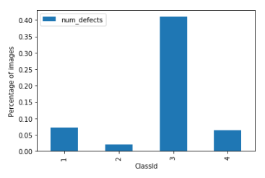
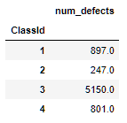
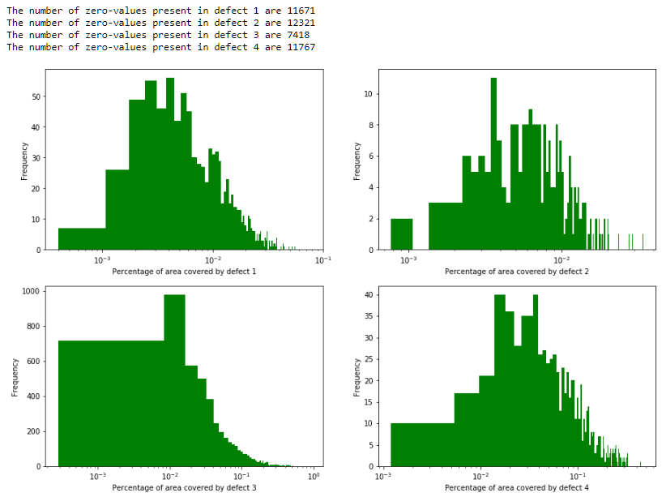
Exploratory Data Analysis
Distribution of Defects and their Areas
0.01% - 0.1%
Percentage of area of an image covered by defects 3 and 4
Log-scale used for distribution of areas (pixels occupied by mask / total pixels) to better visualize the spread
Absolute and Relative Number of Defects in the Dataset
40%
Defect 3
Percentage of images that have defect 3
Total Areas covered by each of the 4 Defects on Log Histogram Distributions

Slide 8
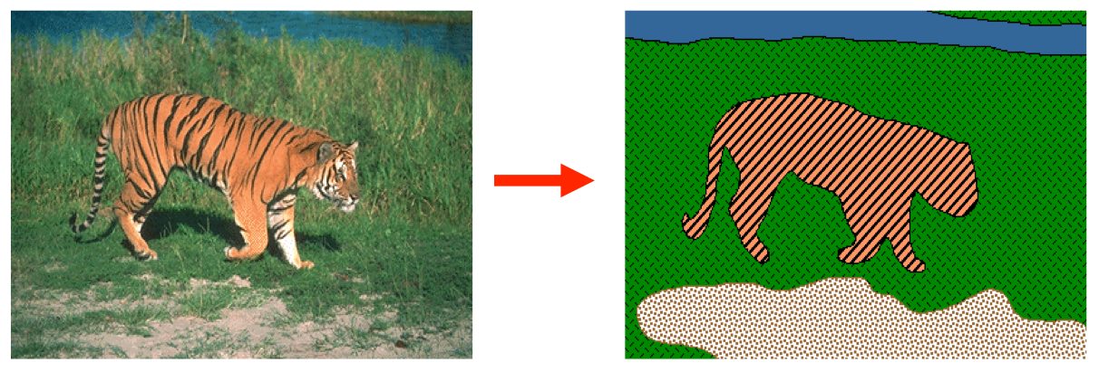
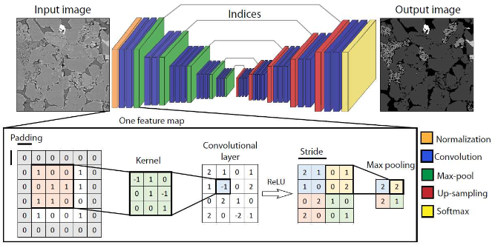
Image Segmentation
Image Segmentation Problem
Image segmentation task, which requires encoding-decoding neural networks (Image source: Stanford AI Introduction to Computer Vision (Amy, 2019))
Involves convolution and max pooling to lower the input image dimensions
Then employs deconvolution and concatenation to reconstruct input image
Mask labels then are used on this reconstructed image to train model
Image segmentation describing the convolution, max-pool and deconvolution operations. (image source: (Sadegh Karimpouli, 2019))
Amy, V. a. (2019). Introduction to Computer Vision: Tutorial 3: Image Segmentation. Retrieved 08 02, 2019, from https://ai.stanford.edu/~syyeung/cvweb/tutorial3.html
Sadegh Karimpouli, P. T. (2019). Segmentation of digital rock images using deep convolutional autoencoder networks. Computers and Geosciences, 126(May), 142-150.

Slide 9
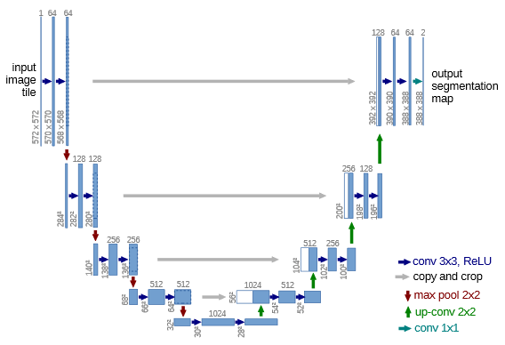
U-Net Architecture
U-Net Architecture
Model used primarily in medical image segmentation techniques
Custom data generator class with the keras.utils.Sequence parameter generally instantiated to feed images in batches
__len__ method returns the number of batches per epoch
__get_item__(index) returns the images (X) and the masks (y) associated with the indices of the training and the validation data
The on_epoch_end() function used to trigger a shuffle of the indices at the end of an epoch, to create a more robust model
Olaf Ronneberger, P. F. (2015). U-Net: Convolutional Networks for Biomedical Image Segmentation. In H. J. Navab N. (Ed.), Medical Image Computing and Computer-Assisted Intervention – MICCAI 2015 (Vol. 9351). Springer, Cham. doi:https://doi.org/10.1007/978-3-319-24574-4_28
U-Net architecture, for a 572 x 572 pixel image. The arrows represent convolution or max-pooling operations. The number of channels or nodes, are denoted at the top of the boxes. The blue boxes represent multi-channel feature maps, and each white box represents copied feature maps. Source: Ronneberger et. al. (Olaf Ronneberger, 2015)

Slide 10
U-Net Architecture
U-Net Architecture
def build_model(input_shape):
inputs = Input(input_shape)
c1 = Conv2D(8, (3, 3), activation='elu', padding='same') (inputs)
c1 = Conv2D(8, (3, 3), activation='elu', padding='same') (c1)
p1 = MaxPooling2D((2, 2)) (c1)
c2 = Conv2D(16, (3, 3), activation='elu', padding='same') (p1)
c2 = Conv2D(16, (3, 3), activation='elu', padding='same') (c2)
p2 = MaxPooling2D((2, 2)) (c2)
c3 = Conv2D(32, (3, 3), activation='elu', padding='same') (p2)
c3 = Conv2D(32, (3, 3), activation='elu', padding='same') (c3)
p3 = MaxPooling2D((2, 2)) (c3)
c4 = Conv2D(64, (3, 3), activation='elu', padding='same') (p3)
c4 = Conv2D(64, (3, 3), activation='elu', padding='same') (c4)
p4 = MaxPooling2D(pool_size=(2, 2)) (c4)
c5 = Conv2D(64, (3, 3), activation='elu', padding='same') (p4)
c5 = Conv2D(64, (3, 3), activation='elu', padding='same') (c5)
p5 = MaxPooling2D(pool_size=(2, 2)) (c5)
c55 = Conv2D(128, (3, 3), activation='elu', padding='same') (p5)
c55 = Conv2D(128, (3, 3), activation='elu', padding='same') (c55)
u6 = Conv2DTranspose(64, (2, 2), strides=(2, 2), padding='same') (c55)
u6 = concatenate([u6, c5])
c6 = Conv2D(64, (3, 3), activation='elu', padding='same') (u6)
c6 = Conv2D(64, (3, 3), activation='elu', padding='same') (c6)
u71 = Conv2DTranspose(32, (2, 2), strides=(2, 2), padding='same') (c6)
u71 = concatenate([u71, c4])
c71 = Conv2D(32, (3, 3), activation='elu', padding='same') (u71)
c61 = Conv2D(32, (3, 3), activation='elu', padding='same') (c71)
u7 = Conv2DTranspose(32, (2, 2), strides=(2, 2), padding='same') (c61)
u7 = concatenate([u7, c3])
c7 = Conv2D(32, (3, 3), activation='elu', padding='same') (u7)
c7 = Conv2D(32, (3, 3), activation='elu', padding='same') (c7)
u8 = Conv2DTranspose(16, (2, 2), strides=(2, 2), padding='same') (c7)
u8 = concatenate([u8, c2])
c8 = Conv2D(16, (3, 3), activation='elu', padding='same') (u8)
c8 = Conv2D(16, (3, 3), activation='elu', padding='same') (c8)
u9 = Conv2DTranspose(8, (2, 2), strides=(2, 2), padding='same') (c8)
u9 = concatenate([u9, c1], axis=3)
c9 = Conv2D(8, (3, 3), activation='elu', padding='same') (u9)
c9 = Conv2D(8, (3, 3), activation='elu', padding='same') (c9)
outputs = Conv2D(4, (1, 1), activation='sigmoid') (c9)
model = Model(inputs=[inputs], outputs=[outputs])
adam = Adam(learning_rate=0.001)
model.compile(optimizer=adam, loss=bce_dice_loss, metrics=[dice_coef])
return model
Our particular model uses:
3x3 convolution boxes with padding and rectified linear unit (ReLU) averaging
2x2 max pooling
Adam optimizer with a learning rate of 0.001
Dice Coefficient used as Evaluation Metric
Binary cross-entropy used for loss function
Batch size of 32 images randomly fed for training

Slide 11
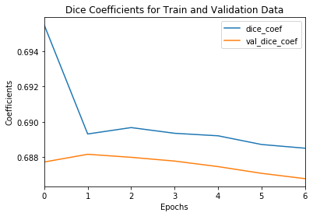
Training Results and Conclusions
Training Results
Trained over 7 epochs, a final train dice coefficient of 0.6885 and validation dice coefficient of 0.6868 was registered
Masks for test images generated using this model’s weights: please find attached submission.xlsx file
Future Work
Number of nodes per layer could be doubled, thus increasing resolution of trained weights
Another convolution and corresponding deconvolution layer can be added
A train-test split more representative of the defect distribution could have improved model accuracy
Train images over other architectures like FCNs, FPN, ParseNet, Mask R-CNN, EncNet etc.
Dice coefficients for the training and the validation datasets, over each epoch

Slide 12
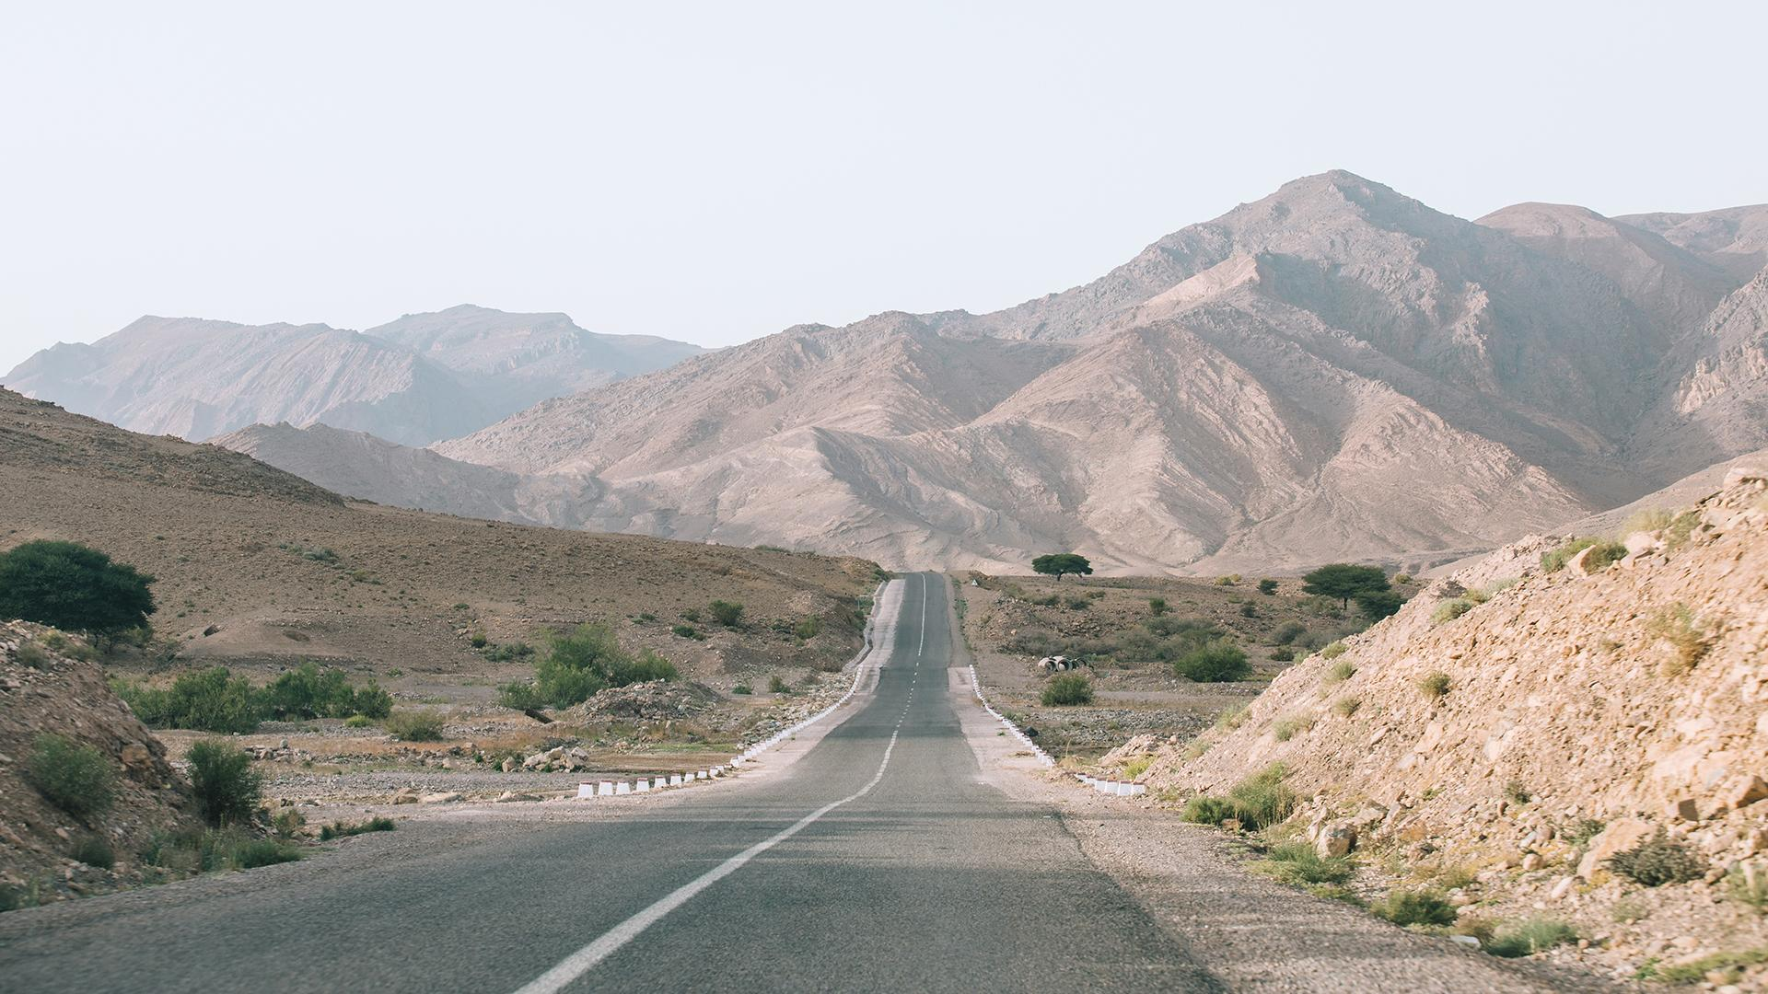
Credits
Mentor guidance and support by Dipanjan Sarkar
Dataset by Kaggle, Inc.
Presentation template by Slidesgo
Icons by Flaticon
Infographics by Freepik
Images created by Freepik

